Slide 1


ARONNOK
FIND RARE HYBRID PLANTS

Slide 2
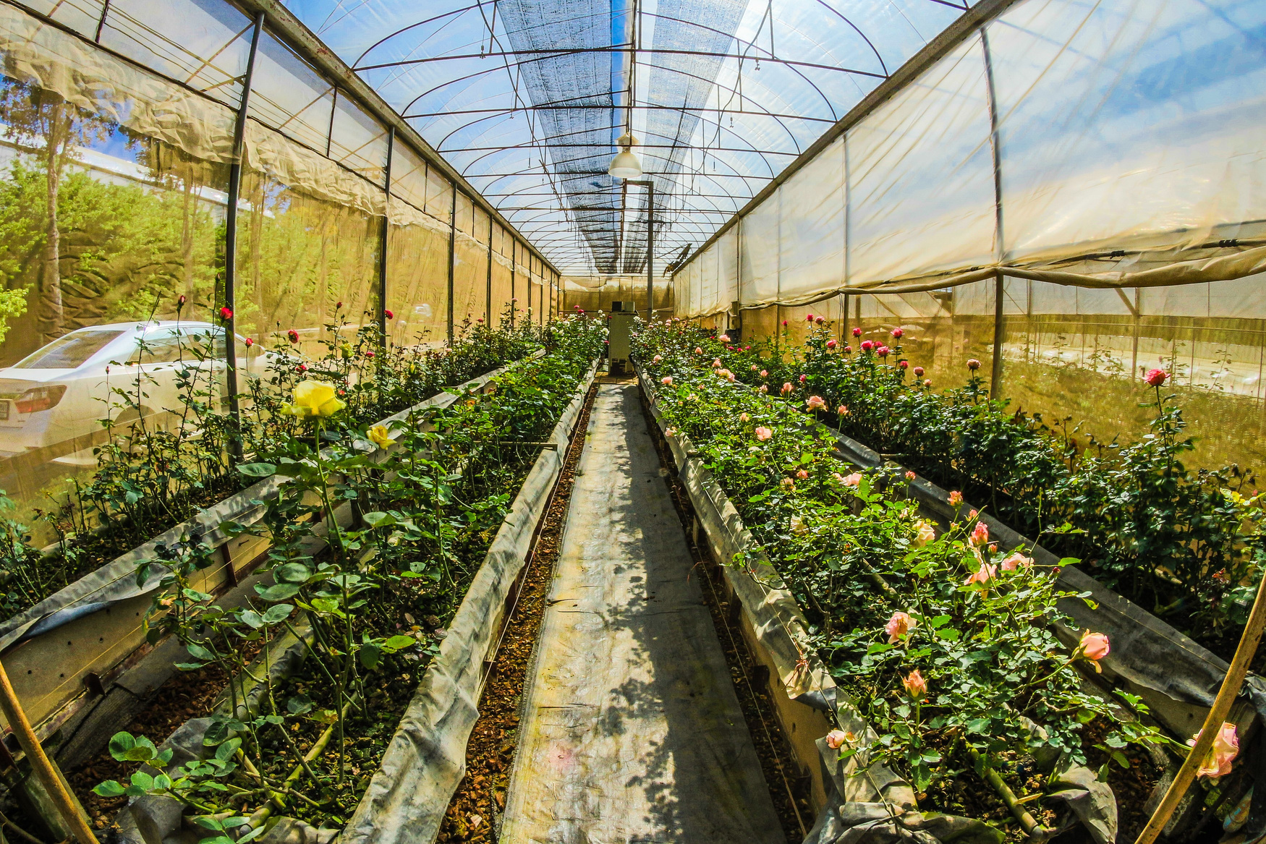

PREPARED BY
Group 4
SUMAIYA SAEHA- 1905033
FARIHA ZAMAN AURIN- 1905049
DEBJANY GHOSH ARONNO- 1905053

Slide 3
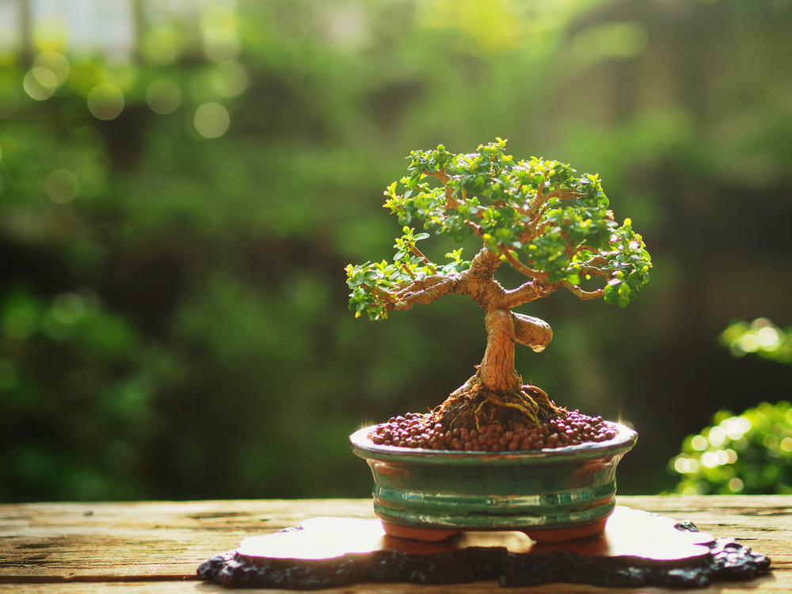
OVERVIEW
Explore a botanical wonderland on our website dedicated to rare hybrid plants. This is a website that offers a unique and engaging platform for plant enthusiasts. Discover detailed information on each rare hybrid, transparent pricing, and user-friendly shopping. Engage with a community passionate about extraordinary plants through forums.

Slide 4
PROJECT SCOPE
Plant Listings
Purchase from user
Forum
Detailed database with rarity indicators and transparent pricing. In-depth information on genetics, unique features, and care requirements.
A space for users to interact, share experiences, and seek advice.
A selling platform from client’s view
Easy navigation
Recommendation
User Accounts
Organized for search filters and personalized searches.
Based on user’s buying history, search history and wishlists
Personalized accounts with a wishlist and notification feature.

Slide 5
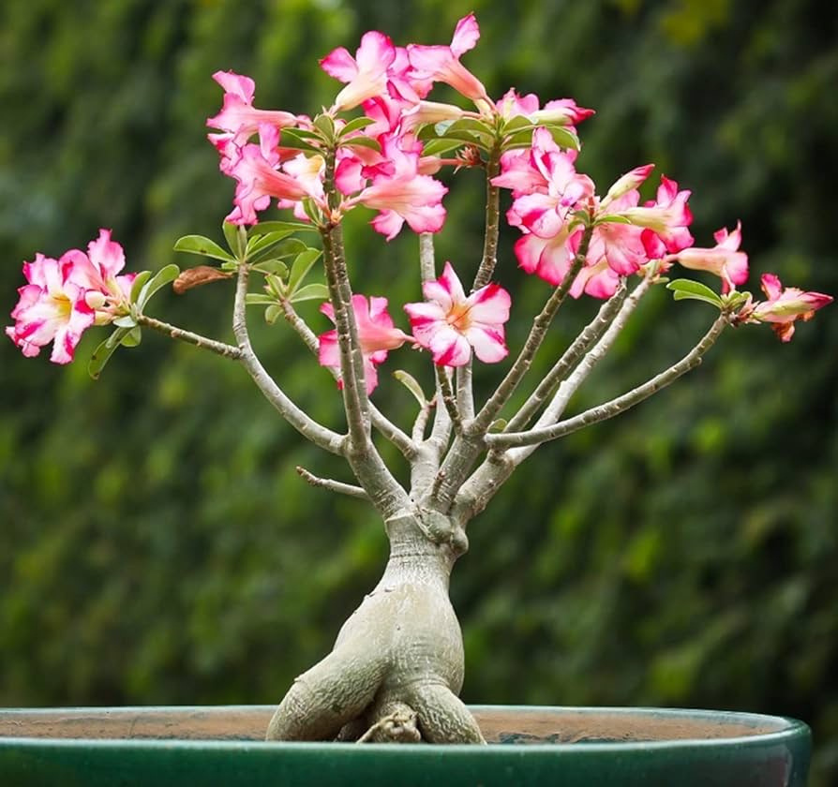
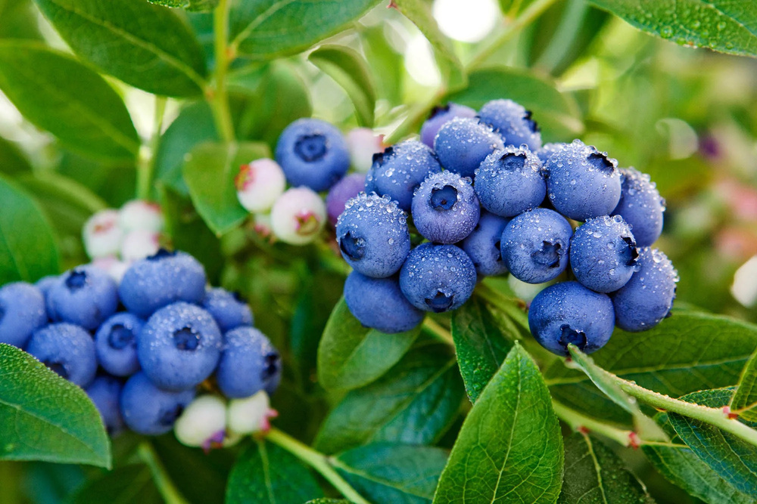
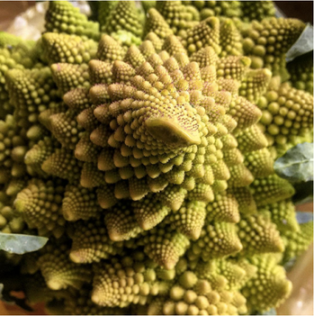
Uniqueness
01. Combined platform
Vibrant digital space that unites passionate plant lovers. People who are unable to take care of their plants can sell-off their plants here. Buyers can discover a diverse marketplace with curated plant selections, while sellers can showcase and share their botanical treasures. ALL IN ONE
02. Dedicated site for cross-breed plants
There are few nursery websites available for selling ordinary, common and easily available plants. This website is dedicated for precious remarkable plants like bansai, hybrid cactus, mixed breed like tangelo, pineberry etc. It’s like a diversion from the monotonous life.

Slide 6
CORE FEATURES
User module
can maintain wishlist
can request for a new plant
can sell his plants if needed
get suggestions and meet up his queries from forum
put a review about purchase and service
pre-booking facilities
can participate in auction (optional)

Slide 7
SYSTEM CORE FEATURES
provide recommendation based on history
notify customers on various aspects relevant to him/her
in-depth search and filter options
advertise new plants
maintaining customer wishlist

Slide 8
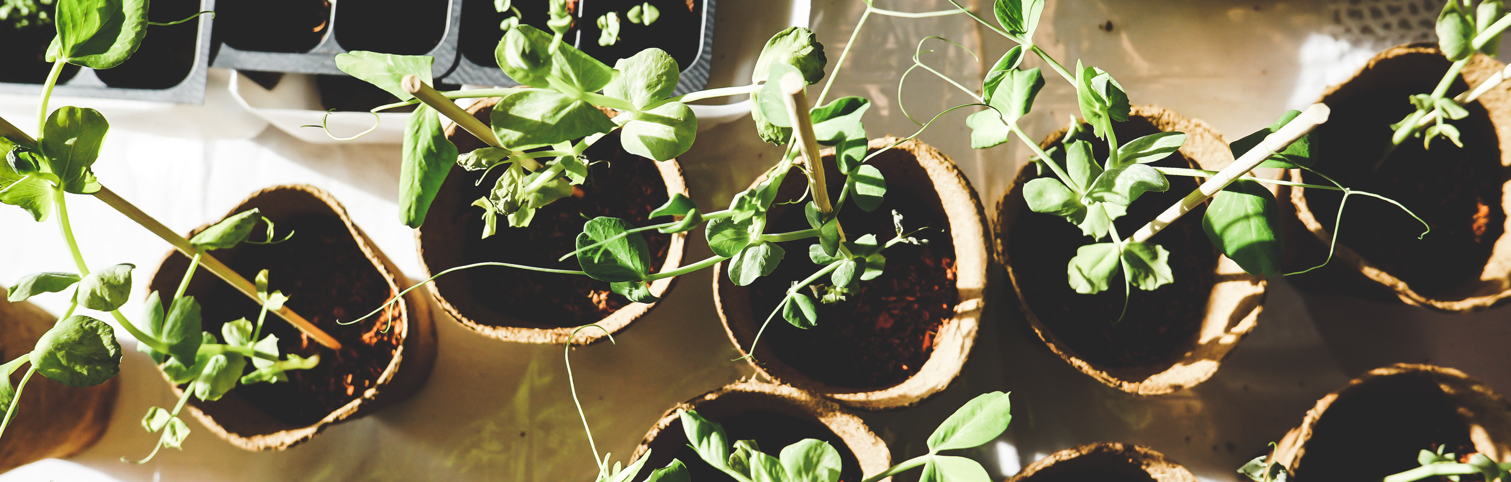
Our motivation for this project stems from a shared passion for plants and a desire to create a vibrant online community where enthusiasts can seamlessly buy, sell, and share their botanical treasures. We believe in fostering connections and enhancing the overall experience for plant lovers globally. This project is driven by our commitment to cultivating a digital space that celebrates the joy of plants and brings together a community that shares our love for the green world.
Motivation

Slide 9

"Garden as though you will live forever."
William Kent
THANK YOU

